Slide 1

APPLICATION TRACKING SYSTEM
PRESENTED BY
B.SREELATHA (N140614)
U.MAHESH BABU(N140597)
M.GOPICHAND(N140628)

Slide 2
Contents:-
Abstract.
Introduction.
Present System.
Proposed System.
Requirements.
System Modules.
Use case Diagrams.
Project Overview.
Benefits of Application Tracking System.
Conclusion.

Slide 3
Abstract:-
Application tracking system is a web based application .It has both admin and user module.
The main objective of this this Application tracking System is to verify the application.
By this the student and administrator interaction is reduces for the certificate verification work .It Saves a lot of time.
Student’s can upload their files and their application will be verified by AO,FO, and finally the director sir will approve the application .
If the application have any mistakes it will be rejected by administrators. Student can track their application with the help of “application tracking “ module.

Slide 4
Introduction:-
In earlier the students has to go to administration office for their certificate verification .
It took lot of time and sometimes administrative officers are not available.
Students has to stay in university and it will be difficult for them.
So that we implemented a web application for certificate application . Students upload application through our web application and it will be verified by A.O , F.O and finally approved by Director.
So it saves lot of time and it will be easy for both students and administration.

Slide 5
Present System:-
Students has to meet staff for their application purpose.
If Faculty want any permission from authorities they also meet authorities for approval.
It’s a Time taking and Long process.

Slide 6
PROPOSED SYSTEM:-
To take advantage of the latest technology and to facilitate students to make online uploading application and check status daily weather it is approved or not.
While accepting students requirements , all necessary validations should be done . it should also store the student’s details.
With the help of reference id of application students can track their application.

Slide 7
Requirements :-
Hardware Requirements:
Processor : Intel(R) 2.10GHz
Installed memory (RAM) : 4 GB
Hard Disk : 160 GB
Software Requirements:
Operating System: Win 8, Win 9, Win 10 or Linux Operating System.
Front End: HTML5, CSS3, Bootstrap
Back End: PHP, MYSQL
Control End: Java Script
Tools Requirements:
xampp-win32-5.5.19-0-VC11
Sublime text

Slide 8
SYSTEM MODULES:-
Student
  Register
  Login
  Upload application
  Check daily application status
F.O
  Login
  Verification
  Accept or Reject
  Forward
A.O
  Login
  Verification
  Accept or Reject
  Forward

Slide 9
Director
  Login
  Verification
  Accept or Reject

Slide 10
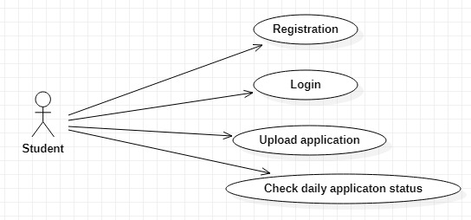
Use case Diagrams:-
Use case diagrams model behavior within a system and helps the developers understand of what the user require. The stick man represents what’s called an actor.
Use case diagram can be useful for getting an overall view of the system and clarifying that can do and more importantly what they can’t do.

Slide 11
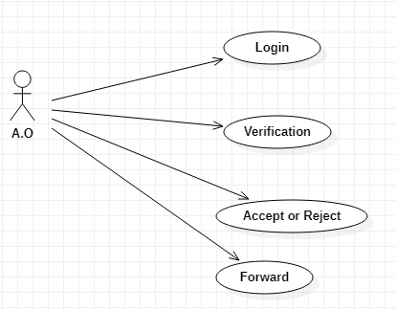

Slide 12
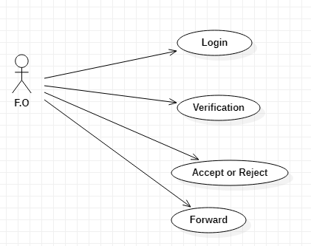

Slide 13
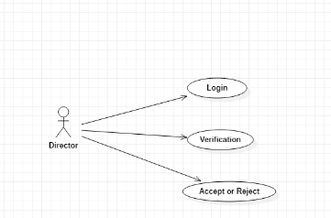

Slide 14
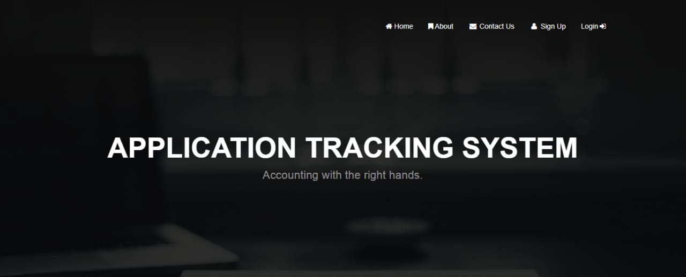
Project overview:-
Open the Application tracking system Website and go to the main bar.

Slide 15
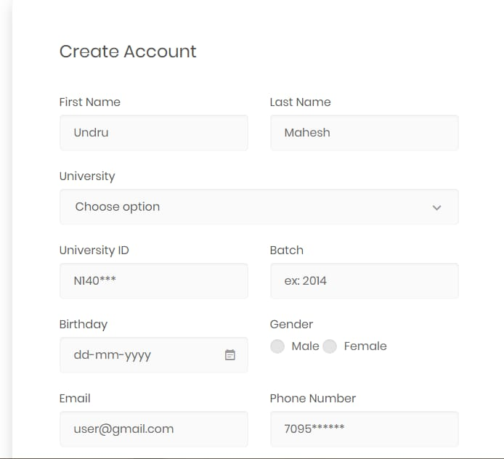
Step-2:-
Then Go to The Registration form

Slide 16
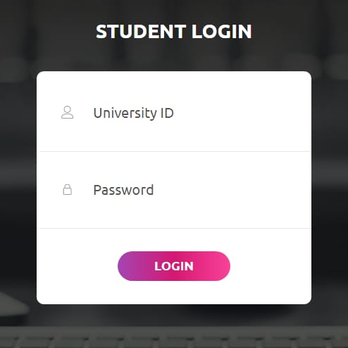
Student Login

Slide 17
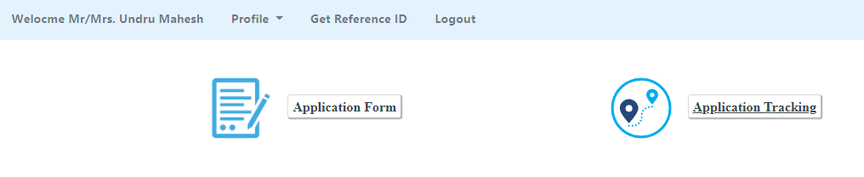
Student home page

Slide 18
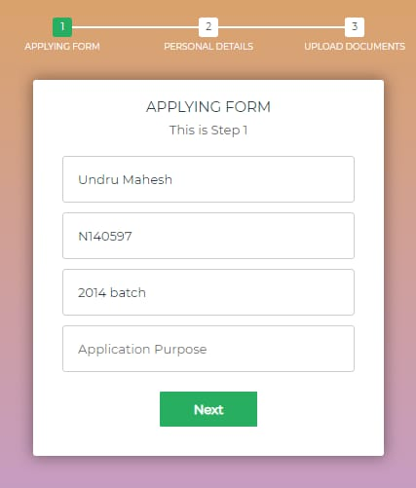
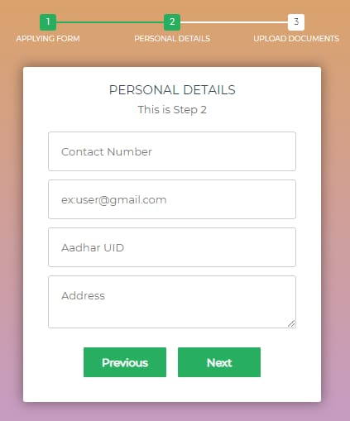
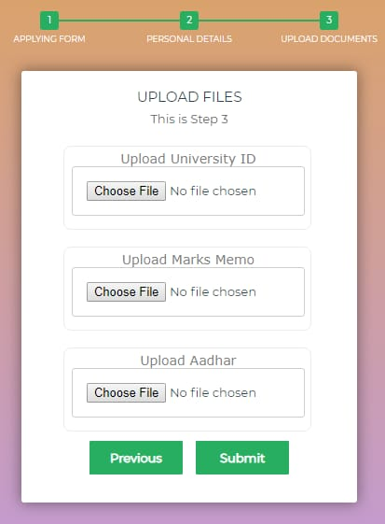
Student applying form

Slide 19
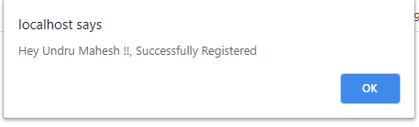
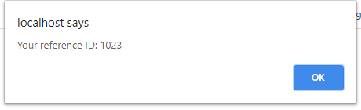
After submitting application form

Slide 20
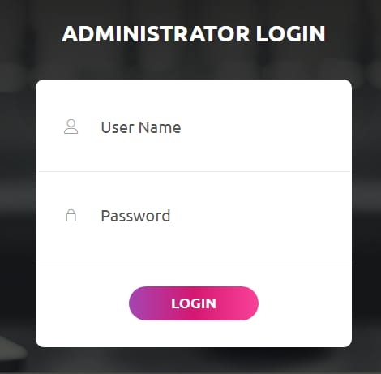
Administrator Login page

Slide 21
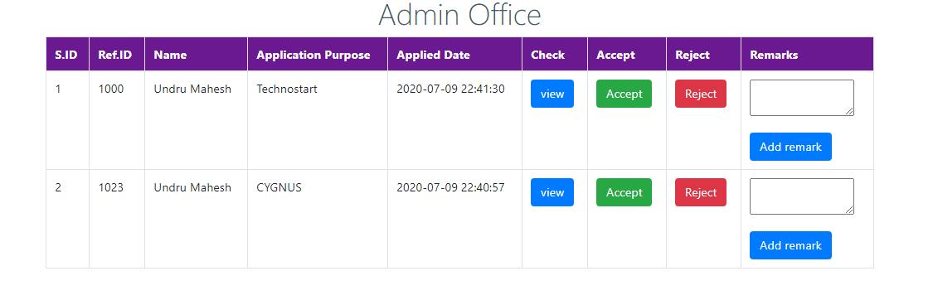
Admin Office Home page

Slide 22
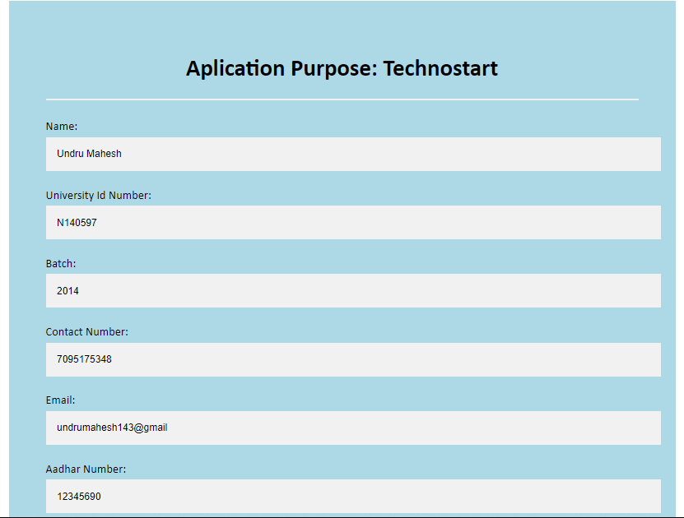
Verifying the application

Slide 23
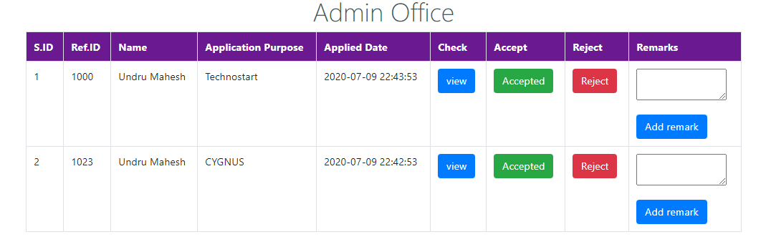
After verifying the application Admin can accept or reject the application

Slide 24
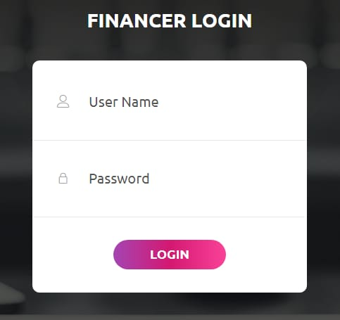
Financer Login page

Slide 25
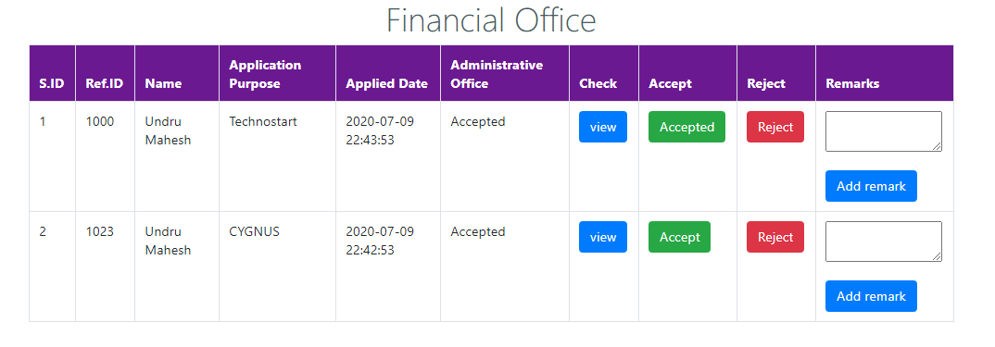
Financial Office

Slide 26
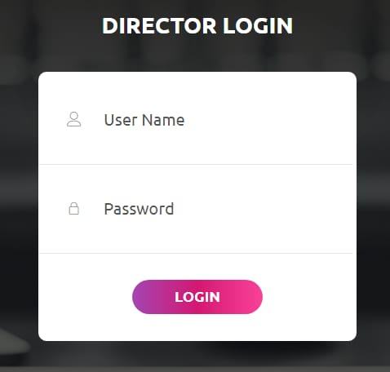
Director Login page

Slide 27
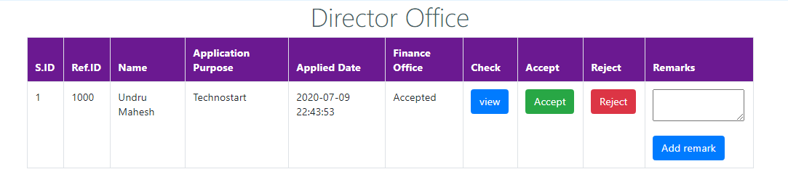
Director Home page

Slide 28
Student home page

Slide 29
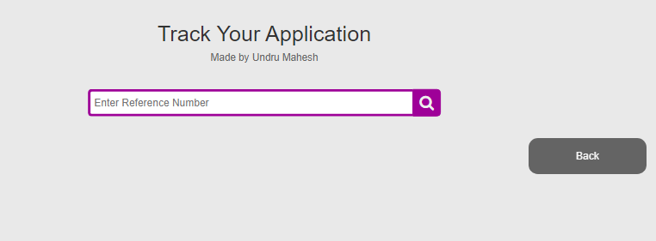
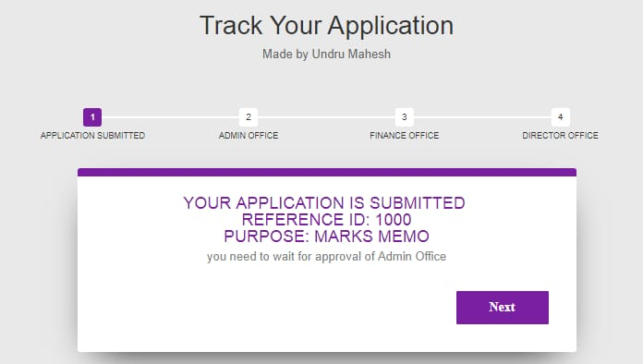
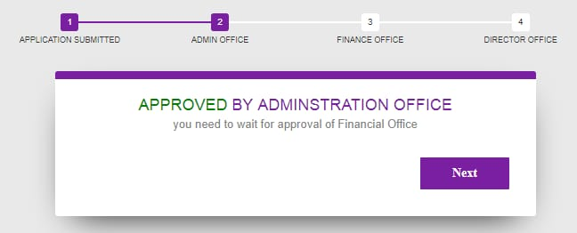
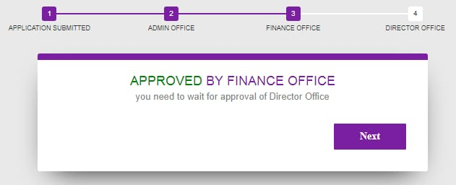
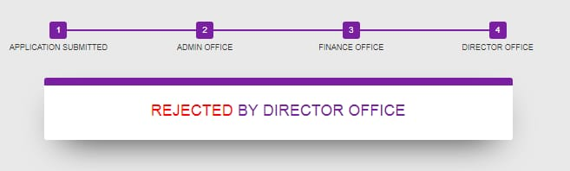
Track your application

Slide 30
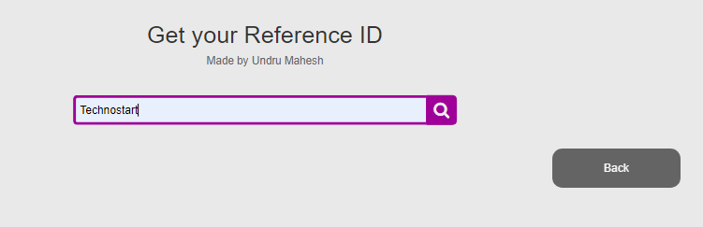
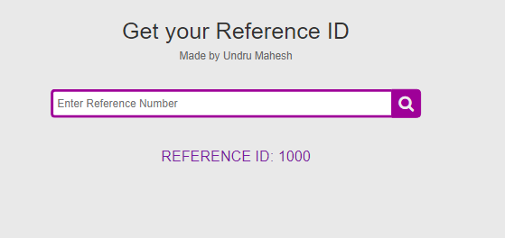
Get reference id

Slide 31
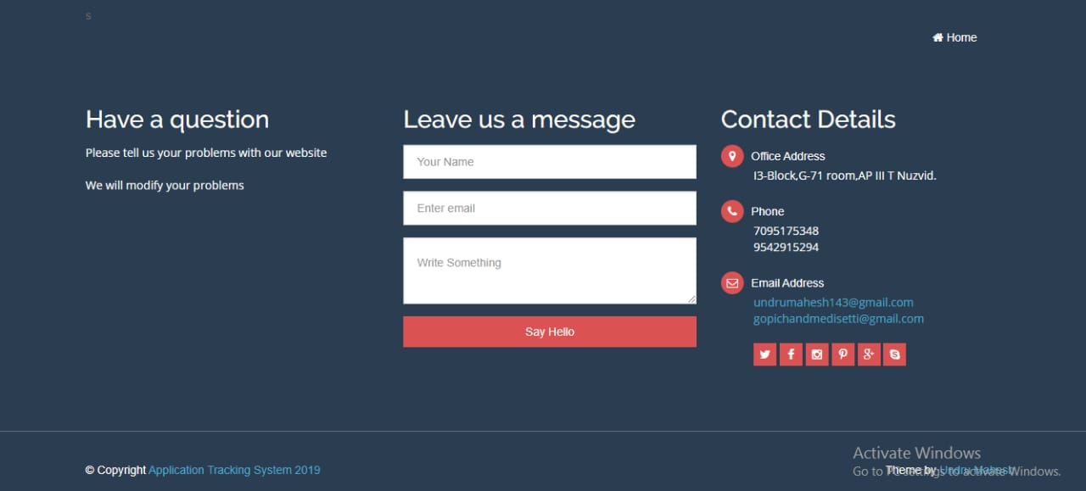
Contact details

Slide 32
Benefits of implementing Application tracking system:-
Got information about application weather it is approved or not.
Saves the time.
It will reduce the work.
It reduce the interaction between students and Administration.

Slide 33
Conclusion:-
Finally in application tracking system, we have a system where student upload a document and it will be verified by AO , FO , and finally approved by Director . Student can check their document status weather it is approved or not . The time will reduced .

Slide 34
Thank you !!!

